Slide 1
Orchid fleck dichorhavirus: a new Brevipalpus transmitted virus fresh from Florida
A. Fife¹, D. Carrillo², G. Knox³, F. Iriarte⁴, K. Dey⁵, A. Roy⁶, R. Ochoa⁷, G. Bauchan⁸, M. Paret^{4,9}, X. Martini¹* ¹ University of Florida, Department of Entomology and Nematology, North Florida Research and Education Center, Quincy FL 32351 ² University of Florida, Department of Entomology and Nematology, Tropical Research and Education Center, Homestead FL 33031 ³ University of Florida, Department of Environmental Horticulture, North Florida Research and Education Center, Quincy FL 32351 ⁴ University of Florida, Department of Plant Pathology, North Florida Research and Education Center, Quincy FL 32351 ⁵ The Florida Department of Agriculture and Consumer Services, Division of Plant Industry, Section of Plant Pathology, Doyle Conner Building, 1911 SW 34th street, Gainesville, FL 32608 ⁶ United States Department of Agriculture – Agriculture Research Service, Molecular Plant Pathology Laboratory, 10300 Baltimore Ave, Bldg. 4 BARC-West, Beltsville, MD 20705 ⁷ United States Department of Agriculture - Agriculture Research Service, Systematic Entomology Laboratory 10300 Baltimore Ave, Bldg. 5 BARC-West, Beltsville, MD 20705 ⁸ United States Department of Agriculture - Animal and Plant Health Inspection Service, Electron and Confocal Microscopy Unit, Bldg. 12 BARC-West, 10300 Baltimore Ave, Beltsville, MD 20705 ⁹ Plant Pathology Department, University of Florida, Gainesville, FL 32611

Slide 2
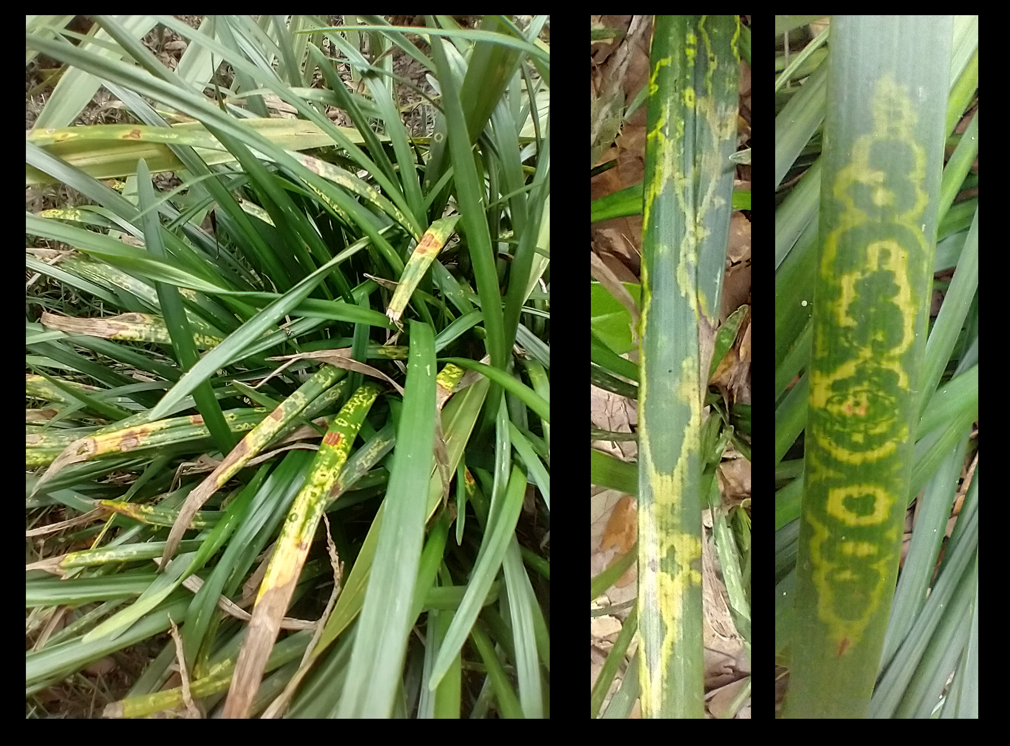
Chlorotic ringspot symptoms on Giant Lilyturf (Liriope spp., cv. ‘Gigantea’)

Slide 3
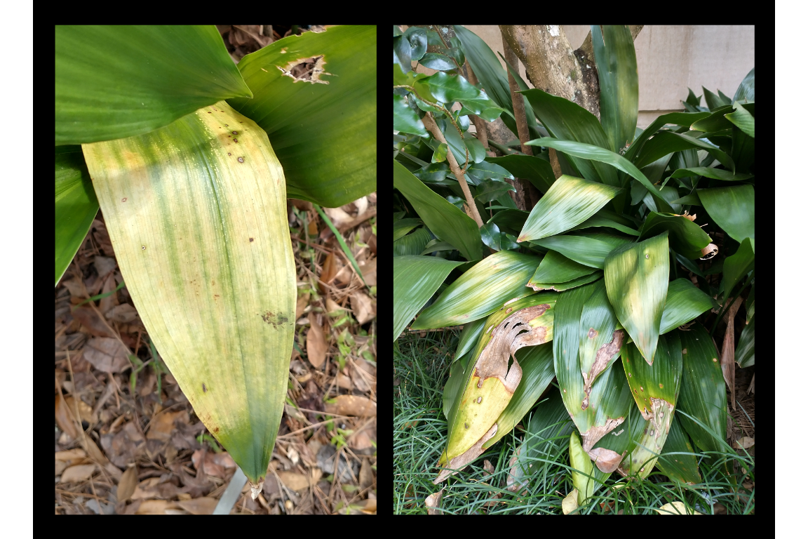
Chlorotic leaves on Cast Iron Plant (Aspidistra elatior)

Slide 4
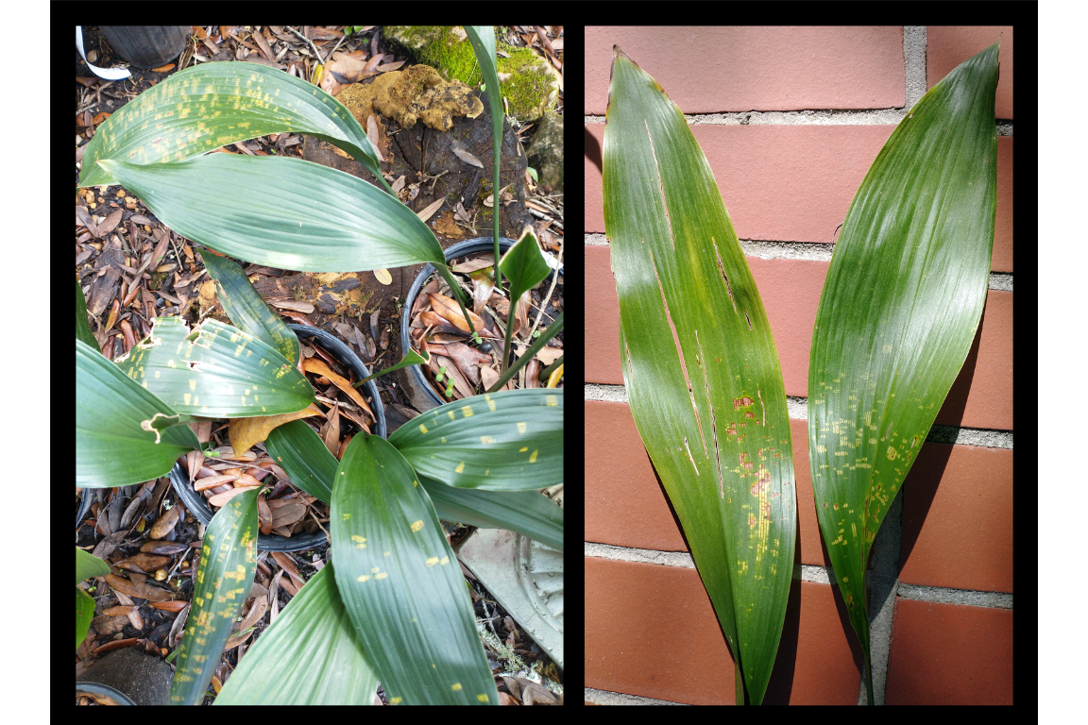
Chlorotic spots on A. elatior - Early infection?

Slide 5
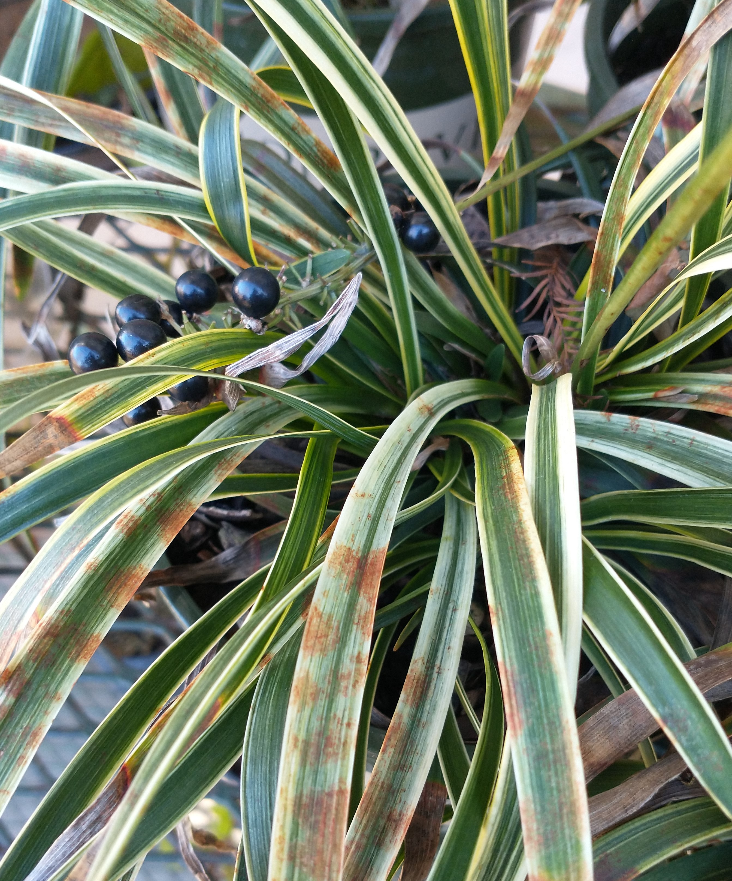
What was causing these symptoms?
Tested negative for begomovirus, potyvirus, tospovirus as well as for Impatiens necrotic spot virus, Tobacco mosaic virus and Tomato spotted wilt virus
Sent to the Florida Department of Agriculture and Consumer Services (FDACS) $→$ sent to USDA
Symptoms on varigated Ophiopogonae

Slide 6
Confirmation: Orchid fleck dichorhavirus (OFV)
Identified using OFV specific conventional reverse transcription polymerase chain assay (RT-PCR) assay + Sanger sequencing + quantitative RT-PCR (RT-qPCR)
Presence of Orchid fleck dichorhavirus confirmed using OFV generic R2-Dicho-GF and R2-Dicho-GR primers (Roy et al. 2020)
Sanger sequencing of RT-PCR amplicons shared 98% nucleotide identity with orchid strains of OFV: OFV-Orc1 and OFV-Orc2 (GenBank Accession numbers: AB244418 and LC222630) (Kondo et al. 2006, 2017).

Slide 7
What is OFV?
Type member for Dichorhavirus, family Rhabdoviridae
Other dichorhaviruses: Citrus chlorotic spot virus, Citrus leprosis virus N, Clerodendrum chlorotic spot virus and Coffee ringspot virus
OFV infects 50+ plant species, including Orchidaceae, Asparagaceae (Nolinoidaea), and Rutaceae (Citrus)
Flat mites from the genus Brevipalpus Donnadieu (Trombidiformes: Tenuipalpidae) only known vectors of dichorhaviruses
Symptoms of OFV on Oncidium

Slide 8
Worldwide Distribution of OFV
First described infecting Cymbidium orchids in Japan (Doi et al. 1977)
OFV and OFV-like rhabdoviruses have been reported worldwide
Asia, Africa, North America, South America, Europe and Oceania
Prevalence of OFV and its mite vector is thought to be associated with the movement of infected orchids (Dietzgen et al. 2018)

Slide 9
World Map of OFV distribution
FALSE Checking rgeos availability: TRUE

Slide 10
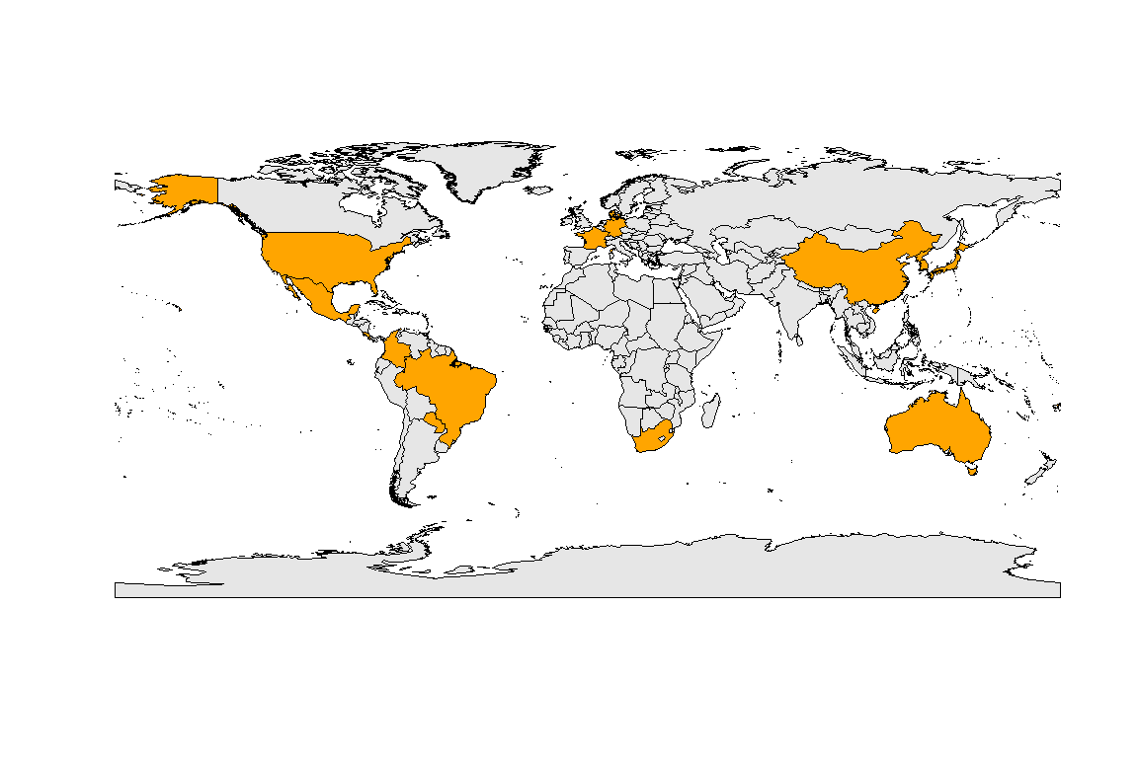

Slide 11
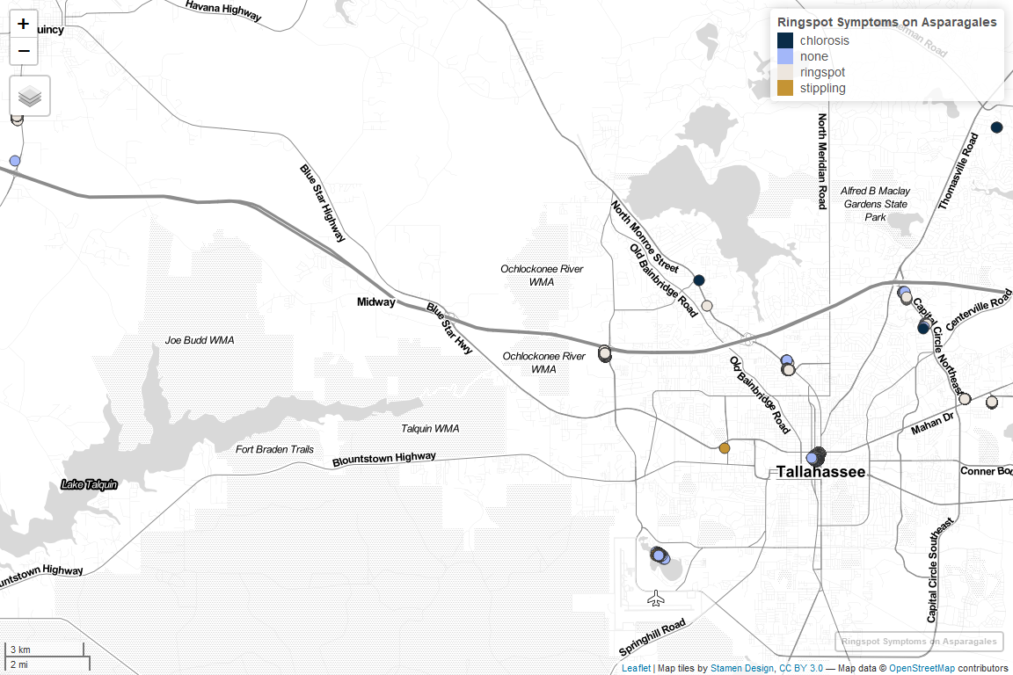
Map of OFV distribution in Tallahassee

Slide 12
Mites Recovered During Our Survey
Unidentified eriophyid mite
Three Brevipalpus mite species were recovered from OFV-infected plants:
Brevipalpus californicus sensu lato
B. obovatus Donnadieu
B. confusus Banks
One of these species is presumably responsible for OFV transmission
Cryo-SEM to help determine Brevipalpus species identity
Various Brevipalpus spp. live in Florida

Slide 13
The Main Suspect: B. californicus sensu lato
Brevipalpus californicus s.l

Slide 14
- Brevipalpus californicus (Banks) group are the only known to transmit OFV in a persistent propagative manner - Brevipalpus mite species complex contains cryptic species $→$ develop molecular methods?

Slide 15
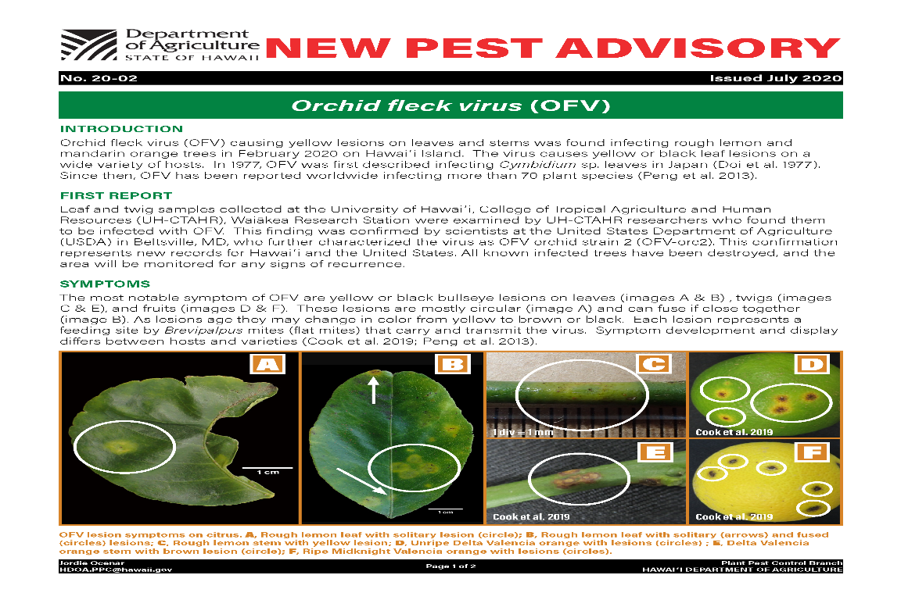
OFV is an issue for Florida agriculture
The dichorhavirus that infects citrus in Hawaii, Mexico, Colombia, and South Africa are identical to the OFV in gene order, content, and the genome sequence.
ICTV: Officially, OFV consists of two orchid strains (OFV-Orc1 and OFV-Orc2) and two citrus strains (OFV-Cit1 and OFV-Cit2)
Orchid strains of OFV infects citrus (Roy et al. 2020), but none of the citrus strains have been reported from any orchid species
OFV in Florida represents a concern for horticulturists who grow orchids, Liriope, Ophiopogon, or other susceptible Asparagaceae species which are commonly used in landscaping

Slide 16
Acknowledgements
We would like to give a special thanks to the Tallahassee Museum for their patience, cooperation, and support with collecting plant samples. We also want to thank Drs. Sam Bolton, FDACS and Aline Tassi, Univ. of Sao Paulo, Brazil for checking the mites we have sent for species validation. We are especially indebted to the late Dr. Gary Bauchan for his contributions to this study and the field of acarology, he will be greatly missed. This research was partly funded by the USDA National Institute of Food and Agriculture, Hatch project FLA-NFC-005607. Mention of trade names or commercial products in this publication is solely for the purpose of providing specific information and does not imply recommendation or endorsement by the USDA; USDA is an equal opportunity provider and employer.

Slide 17
References
Dietzgen, R. G., J. Freitas-Astúa, C. Chabi-Jesus, P. L. Ramos-González, M. M. Goodin, H. Kondo, A. D. Tassi, and E. W. Kitajima. 2018. Dichorhaviruses in their host plants and mite vectors, pp. 119–148. In Advances in Virus Research. Elsevier.
Doi, Y., M. U. Chang, and K. Yora. 1977. Orchid fleck virus. CMI/AAB descriptions of plant viruses.
Kondo, H., K. Hirota, K. Maruyama, I. B. Andika, and N. Suzuki. 2017. A possible occurrence of genome reassortment among bipartite rhabdoviruses. Virology. 508: 18–25.
Kondo, H., T. Maeda, Y. Shirako, and T. Tamada. 2006. Orchid fleck virus is a rhabdovirus with an unusual bipartite genome. Journal of General Virology. 87: 2413–2421.
Roy, A., A. L. Stone, G. Otero-Colina, G. Wei, R. H. Brlansky, R. Ochoa, G. Bauchan, W. L. Schneider, M. K. Nakhla, and J. S. Hartung. 2020. Reassortment of genome segments creates stable lineages among strains of orchid fleck virus infecting citrus in Mexico. Phytopathology. 110: 106–120.

